Slide 1
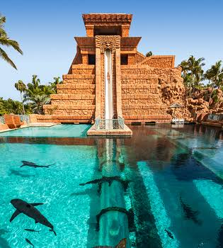
DATE
YOUR NAME
Citizenship 9
Insert some kind of cool picture here

Slide 2
TABLE OF CONTENTS
TABLE OF CONTENTS
WHERE
1
2
3
4
Personal
Community
Global
Aspirational

Slide 3
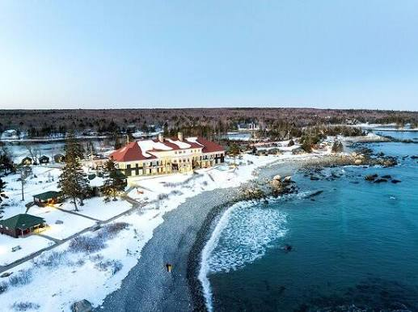
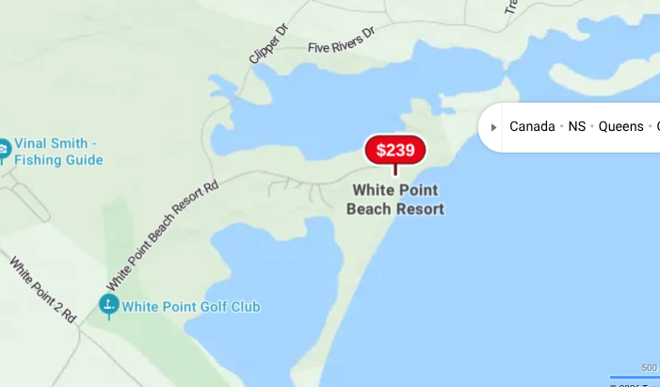
The Personal Place
Cit 9 WHERE
MAP SCREENSHOT (from Bing Maps) | The place i picked is white point. I used to go there every year with my family. We would go in the winter and feed bunnies and swim in the pool. That pool is where i learned how to swim. I chose this place because it is an important part of my childhood. | IMAGE
Notes:
The Personal Place
Reflection: Write a paragraph about a personal place that holds significance for you.
Guiding Questions:: In a second section, describe how your personal perspective shapes the way you see and feel about this place. What stories or memories are tied to this specific location?

Slide 4
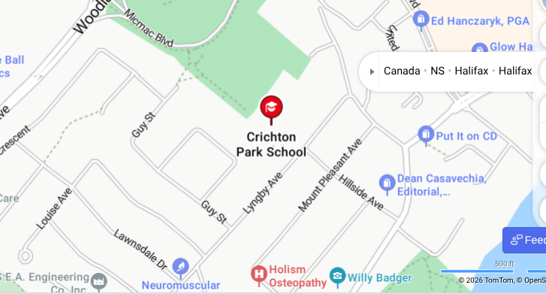
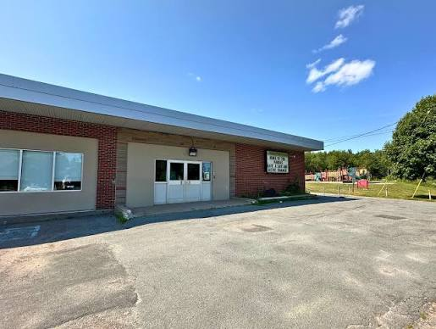
The Community Place
Cit 9 WHERE
MAP SCREENSHOT | When i was younger my mom would always take me and my brother to Crichton Park playground. I also like it because it was my elementary school. One thing i remember is going into the woods behind the school with my brother and making a fort with sticks. | IMAGE
Notes:
Reflection: Write about a significant place in our local community. Tell the story of the place! Who owns it? Why do you like it? Describe something that happened there that you remember.

Slide 5
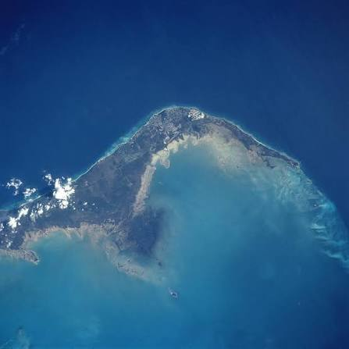
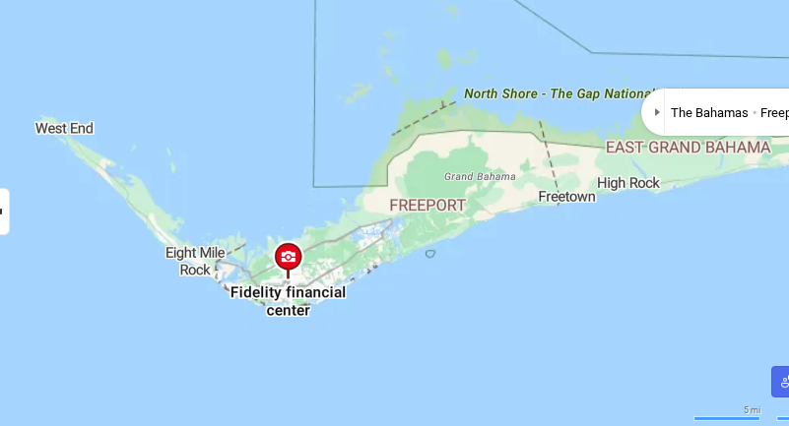
The Global Place
Cit 9 WHERE
MAP SCREENSHOT | Grand bahama island is a very special place to me. I have been going there every year since before i was one. My grandparents own an apartment in the island, they go there every winter because they don't like the cold. This year will be my first year other than covid that i wont be going there with my family. | IMAGE
Notes:
Reflection: Write a story about a place in the world that is part of your family's story.
Guiding Questions: Tell the story of how you and/or your family are connected to this place.
What traditions or values from this place have been passed down to you?
How does this connect to your cultural identity, including things you do and who you are?

Slide 6
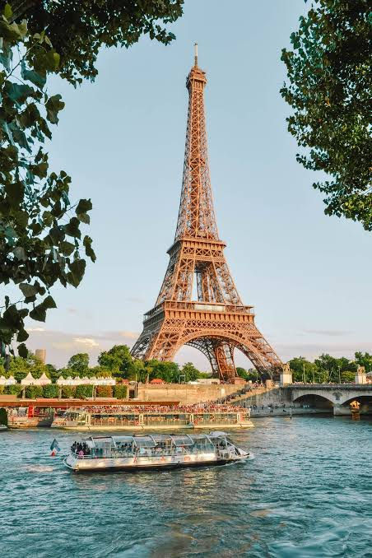
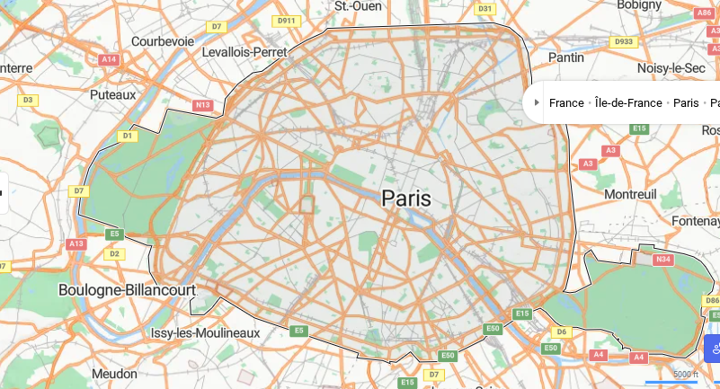
The Aspirational Place
Cit 9 WHERE
MAP SCREENSHOT | I want to go to paris. One thing that draws me to this place is my grandas daad is from there. I also think paris is such a beautiful place and would be so fun to visit. | IMAGE
Notes:
Reflection: Write a story about a place in the world that is part of your family's story.
Guiding Questions: What draws you to this place? What do you hope to learn or experience there? How does this place fit into your hopes for the future?

Slide 7

The Aspirational Place
Cit 9 WHERE
Soundtrack of your life | Post the youtube link here https://www.youtube.com/watch?v=YVVTZgwYwVo | What’s the story on the song? Write here! When i was younger I loved princesses especially elsa and anna. I loved singing this song. And i also loved watching this movie
Notes:
Reflection: Write a story about a place in the world that is part of your family's story.
Guiding Questions: What draws you to this place? What do you hope to learn or experience there? How does this place fit into your hopes for the future?

Slide 8
THANK YOU

